Slide 1

YouTube video analysis
Project MENTOR & GUIDE
SoumyaKanti Chakraborty
Project members
Sundar Sivaraman
Meghana HM
AMLAN Chakravarty
SLN Murthy
Shashi Kiran
Prabharan M

Slide 2
Contents
Problem Statement
Approach, Assumptions & Methodology
How is this useful?

Slide 3



Business Problem
YouTube is an American video-sharing website headquartered in San Bruno, California.
Founded in Feb 2005.
It allows users to upload, view, rate, share, add to playlists, report, comment on videos, and subscribe to other users
It offers a wide variety of user-generated and corporate media videos
Most content on YouTube is uploaded by individuals, but media corporations including CBS, the BBC, Vevo, and Hulu offer some of their material via YouTube as part of the YouTube partnership program
YouTube has become the go to platform for marketing & creating a social media presence. With everyone jumping onto the bandwagon we have seen multitude of corporate channels come up who are trying to capture their share of the huge YouTube audience.
In such a scenario, it can be useful to understand what works on the platform and what does not.
By looking at historical data of YouTube Channels & Videos we are trying to understand the key drivers of popular videos. Using these drivers we want to create a toolkit for a new/existing channel owner who can gather some intelligence on what “might” work for a future video upload.

Slide 4
Approach & Process Methodology – CRISP DM
Data Collection
Data Curation
Exploratory Data Analysis
Predictive Analytics
Insights

Slide 5



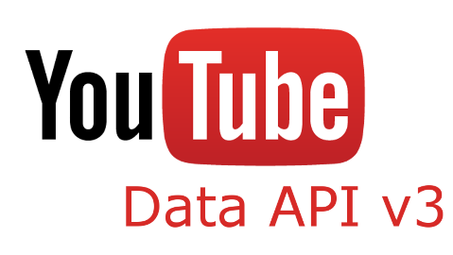

Data collection Process
Users
Us!
YouTube data from YouTube API v3 has been extracted
The below points capture the process of extraction
Step1: Created an account and project in the below link: https://console.developers.google.com
Step2: Enable API for this project in YouTube dev console, so that we can fetch data.
Step3: Analyze Youtube API help documents to identify relevant API links suitable for analysis
Step 4: Developed a Python code to fetch the details from API which copies the data into local spreadsheets for further analysis
Uploaders

Slide 6
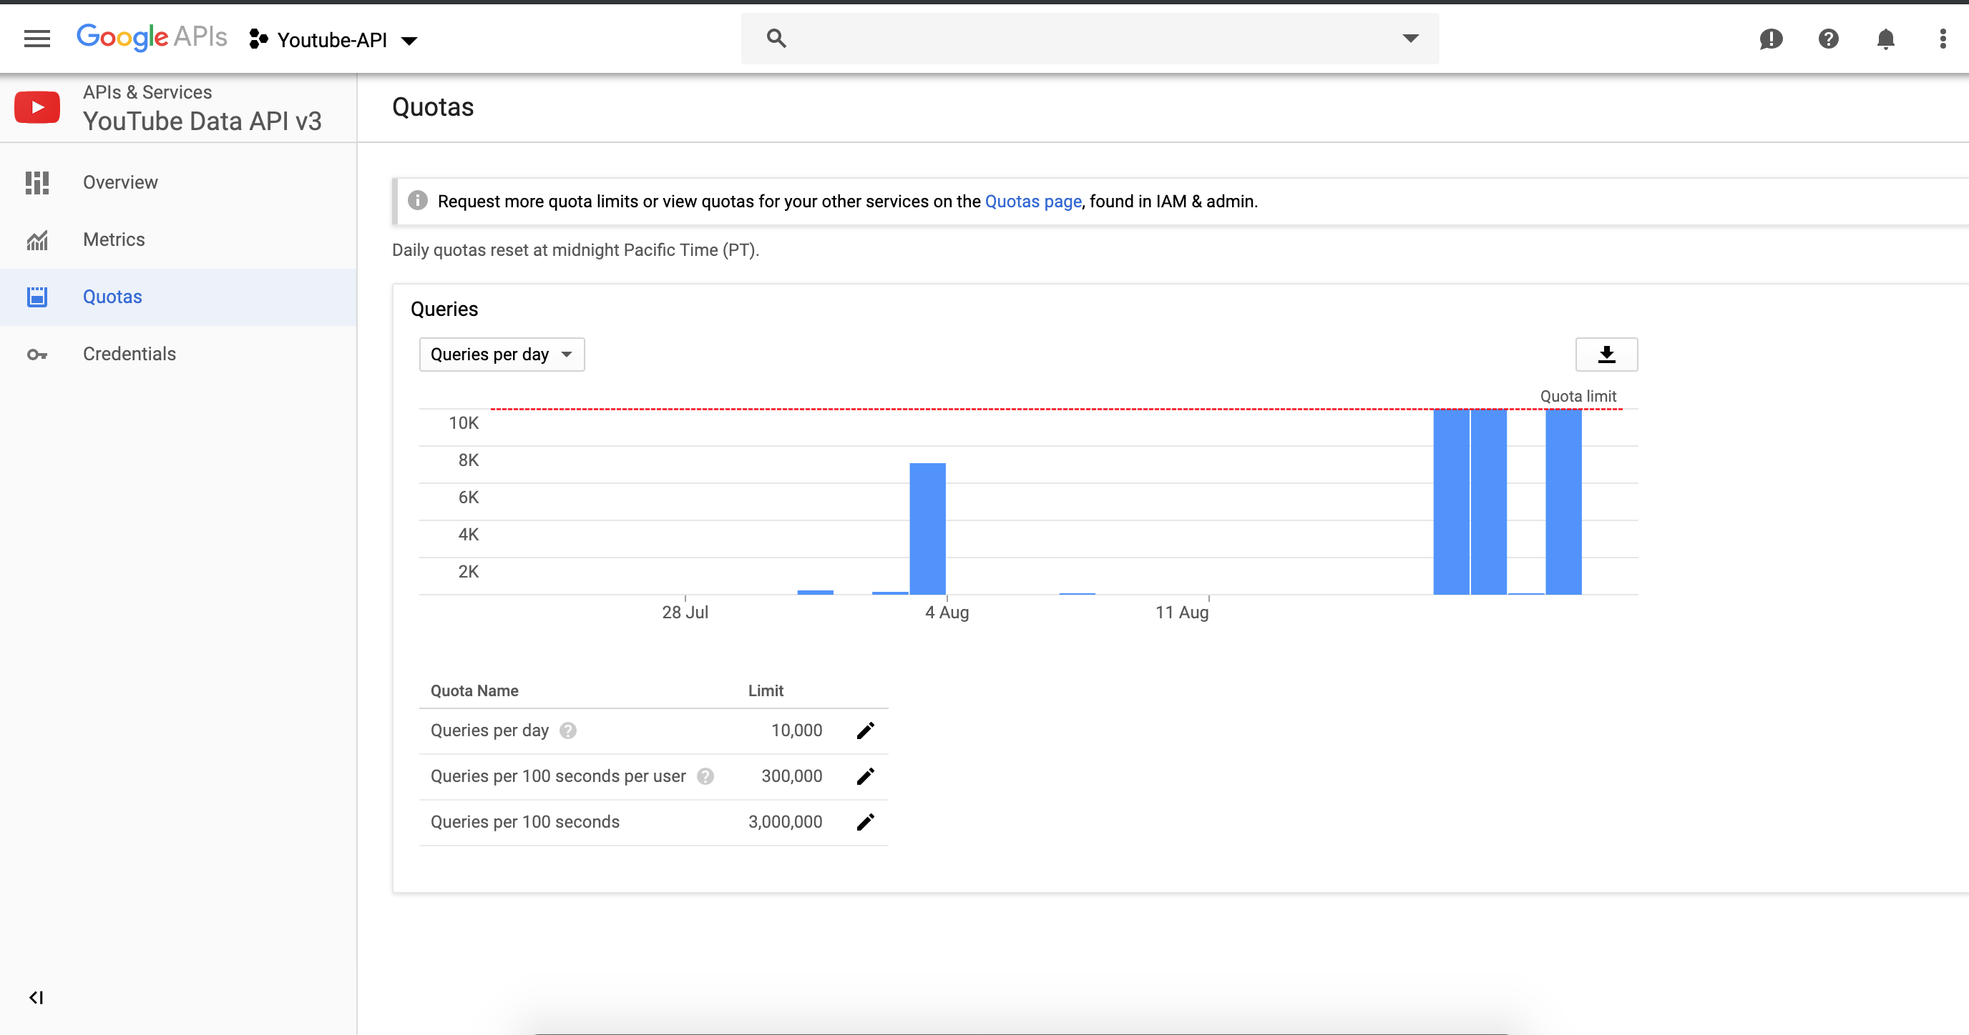

Slide 7
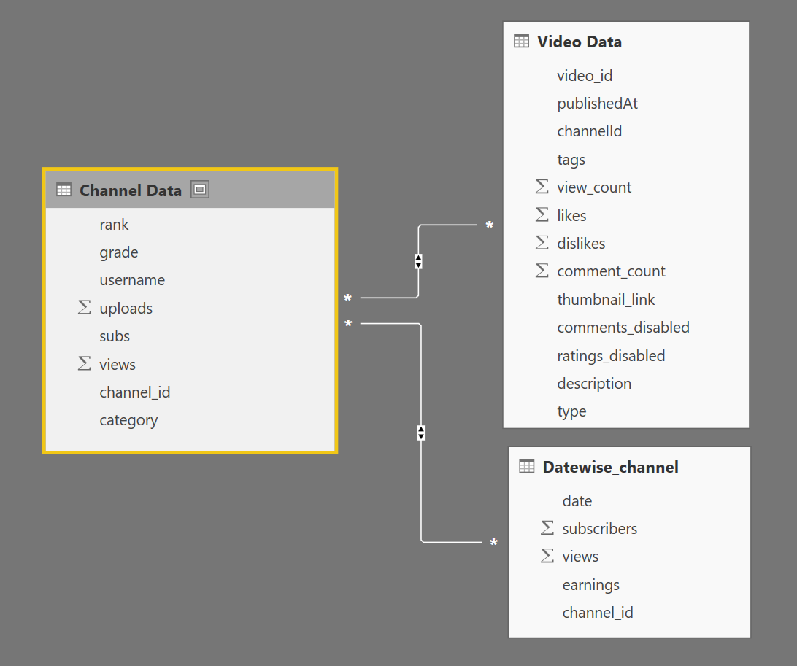
Data Architecture
Assumptions
“Top 30” Channels across “11 different categories” of Videos were considered as “sample” data for this analysis
We used the channel “Ranking” (Top 30) and “video classification” (most viewed etc.) by “SocialBlade” as references for this analysis
All these references were used to filter data for this analysis but after extraction, only the classification of a video being “most viewed” has been retained
All videos uploaded by a channel belong to the same category, i.e. an Auto channel will not upload a video in the News category

Slide 8
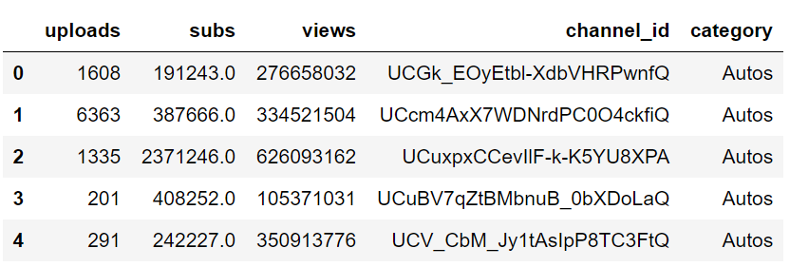
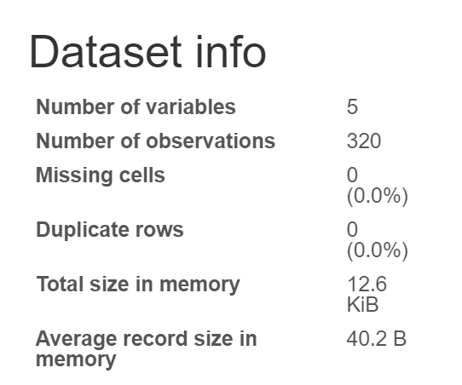
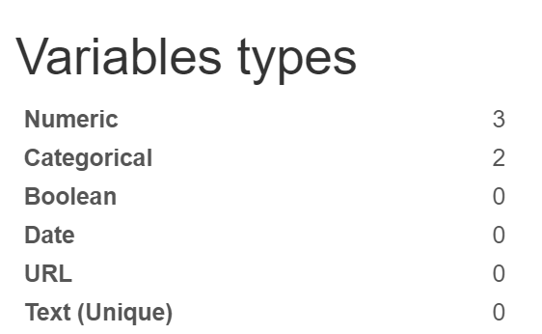
Data Snapshot (Channel Level)
Data description
Data extraction time frame - from 15th May, ’19 to 15th June, ’19
Top 30 channels from 11 different categories like:
Auto
Comedy
Education
Entertainment, etc.
Feature explanation
Uploads – Total no. of uploads made by specific channel
Subs – Total no. of subscribers for a channel
Views – Total no. of channel views across all videos
Category – Video category of channel
Channel ID – Unique identifier for each channel

Slide 9
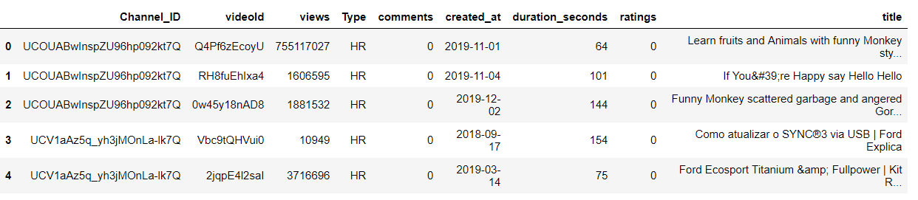
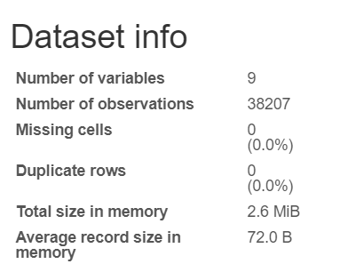
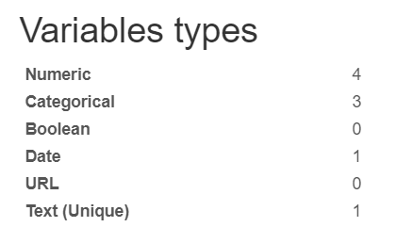
Data Snapshot (Video Level)
Feature Explanation
Channel ID – Unique identifier for each channel
Video ID – Unique identifier for each video
Views – Total no. of channel views across all videos
Type – Highest Rated, Most Viewed, Recent Videos
Comments – No. of comments on video
Created At – Time at which the video was created
Duration – Duration of video in seconds
Rating – No. of likes

Slide 10
Approach & Process Methodology – CRISP DM
Data Collection
Data Curation
Exploratory Data Analysis
Predictive Analytics
Insights

Slide 11





Data Curation
Tasks
Tools Used
Missing Value Treatment
Channels Subscribers had missing values - Imputation with Median (long tailed distribution) across respective categories due to huge spread in subscriber count
Duplicate removal across video data
Converting date type information to datetime data types for appropriate analysis
Extraction of “Video Duration” from API string output in format 01H22M09S, 01H06S, etc.

Slide 12
Approach & Process Methodology – CRISP DM
Data Collection
Data Curation
Exploratory Data Analysis
Predictive Analytics
Insights

Slide 13
Channel – Tableau link
* Tableau Workbook link for EDA

Slide 14
Approach & Process Methodology – CRISP DM
Data Collection
Data Curation
Exploratory Data Analysis
Predictive Analytics
Insights

Slide 15



Predictive Analytics
Can we predict if a video will become popular?
Using “Most Viewed” as proxy for popularity
Classification techniques to predict (1/0) scenario of a video becoming popular or not
Scaling data for improved convergence of algorithms
Dummy creation of categorical variables
Classification techniques used are:
Logistic regression
Random Forest

Slide 16
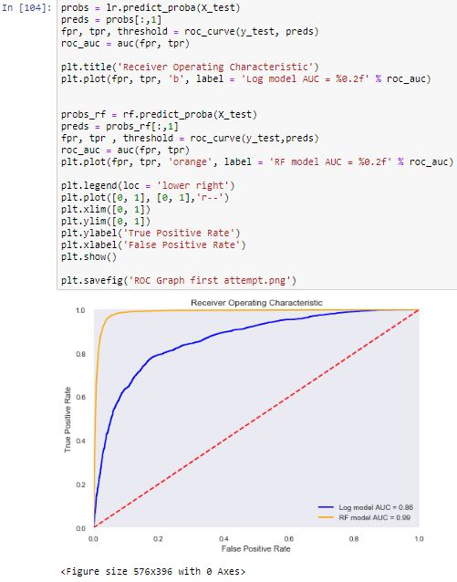
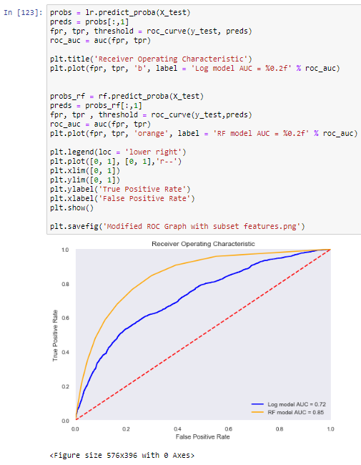
Results
Results with all available features
Results with subset of features
Notes:
Used Logistic regression as base model which had overall accuracy of 72%
Using RandomForest as a classification algorithm as we are interested in drivers of popularity (features of video)
Model Evaluation & Feature optimization
Rerun of Model with new feature set
Feature importance derived using Gini Impurity

Slide 17
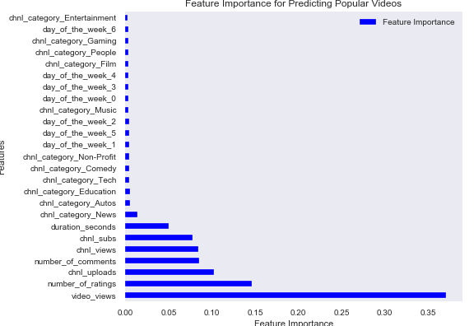
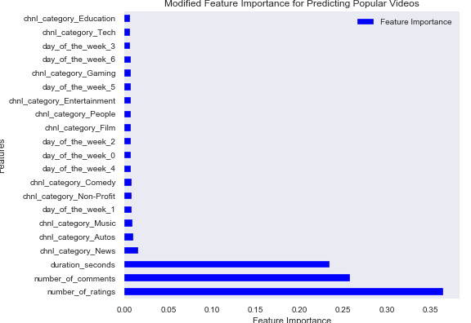
Feature Importance
The First run of Random Forest reveals intuitive dependence of video popularity on “video views” and “channel capabilities”
Due to overfitting of model we removed the dominant variables to understand the relationship between other features
The level of “engagement” drives popularity as we see # of comments & ratings as important features
Day of upload seems to matter, with extreme ends of the week being preferred, i.e. “Tuesday” or “Friday”

Slide 18
Approach & Process Methodology – CRISP DM
Data Collection
Data Curation
Exploratory Data Analysis
Predictive Analytics
Insights

Slide 19


Insights & Uses of our Study
Channel Level Data Insights
Video Level Data Insights
“Music” is one of the safest categories, as it has highest User and Content Stickiness
“Films” & “Education” videos reach a lot of users but fail to generate subscribers
“Tech” & “Auto” categories have loyal subscribers but they look for new content
Categories like Music & Education have higher views at the start and end of week
Other categories like Gaming & Entertainment pick up views in the middle of the week
The level of “engagement” drives popularity as we see “# of comments & ratings” as important features
Day of upload seems to matter, with extreme ends of the week being preferred, i.e. “Tuesday” or “Friday”
“Music” videos have the least “play duration” but they have the highest views
“Films” have highest “play duration” but median viewership

Slide 20

Thank you
EPBA08 – Group 7

